Slide 1
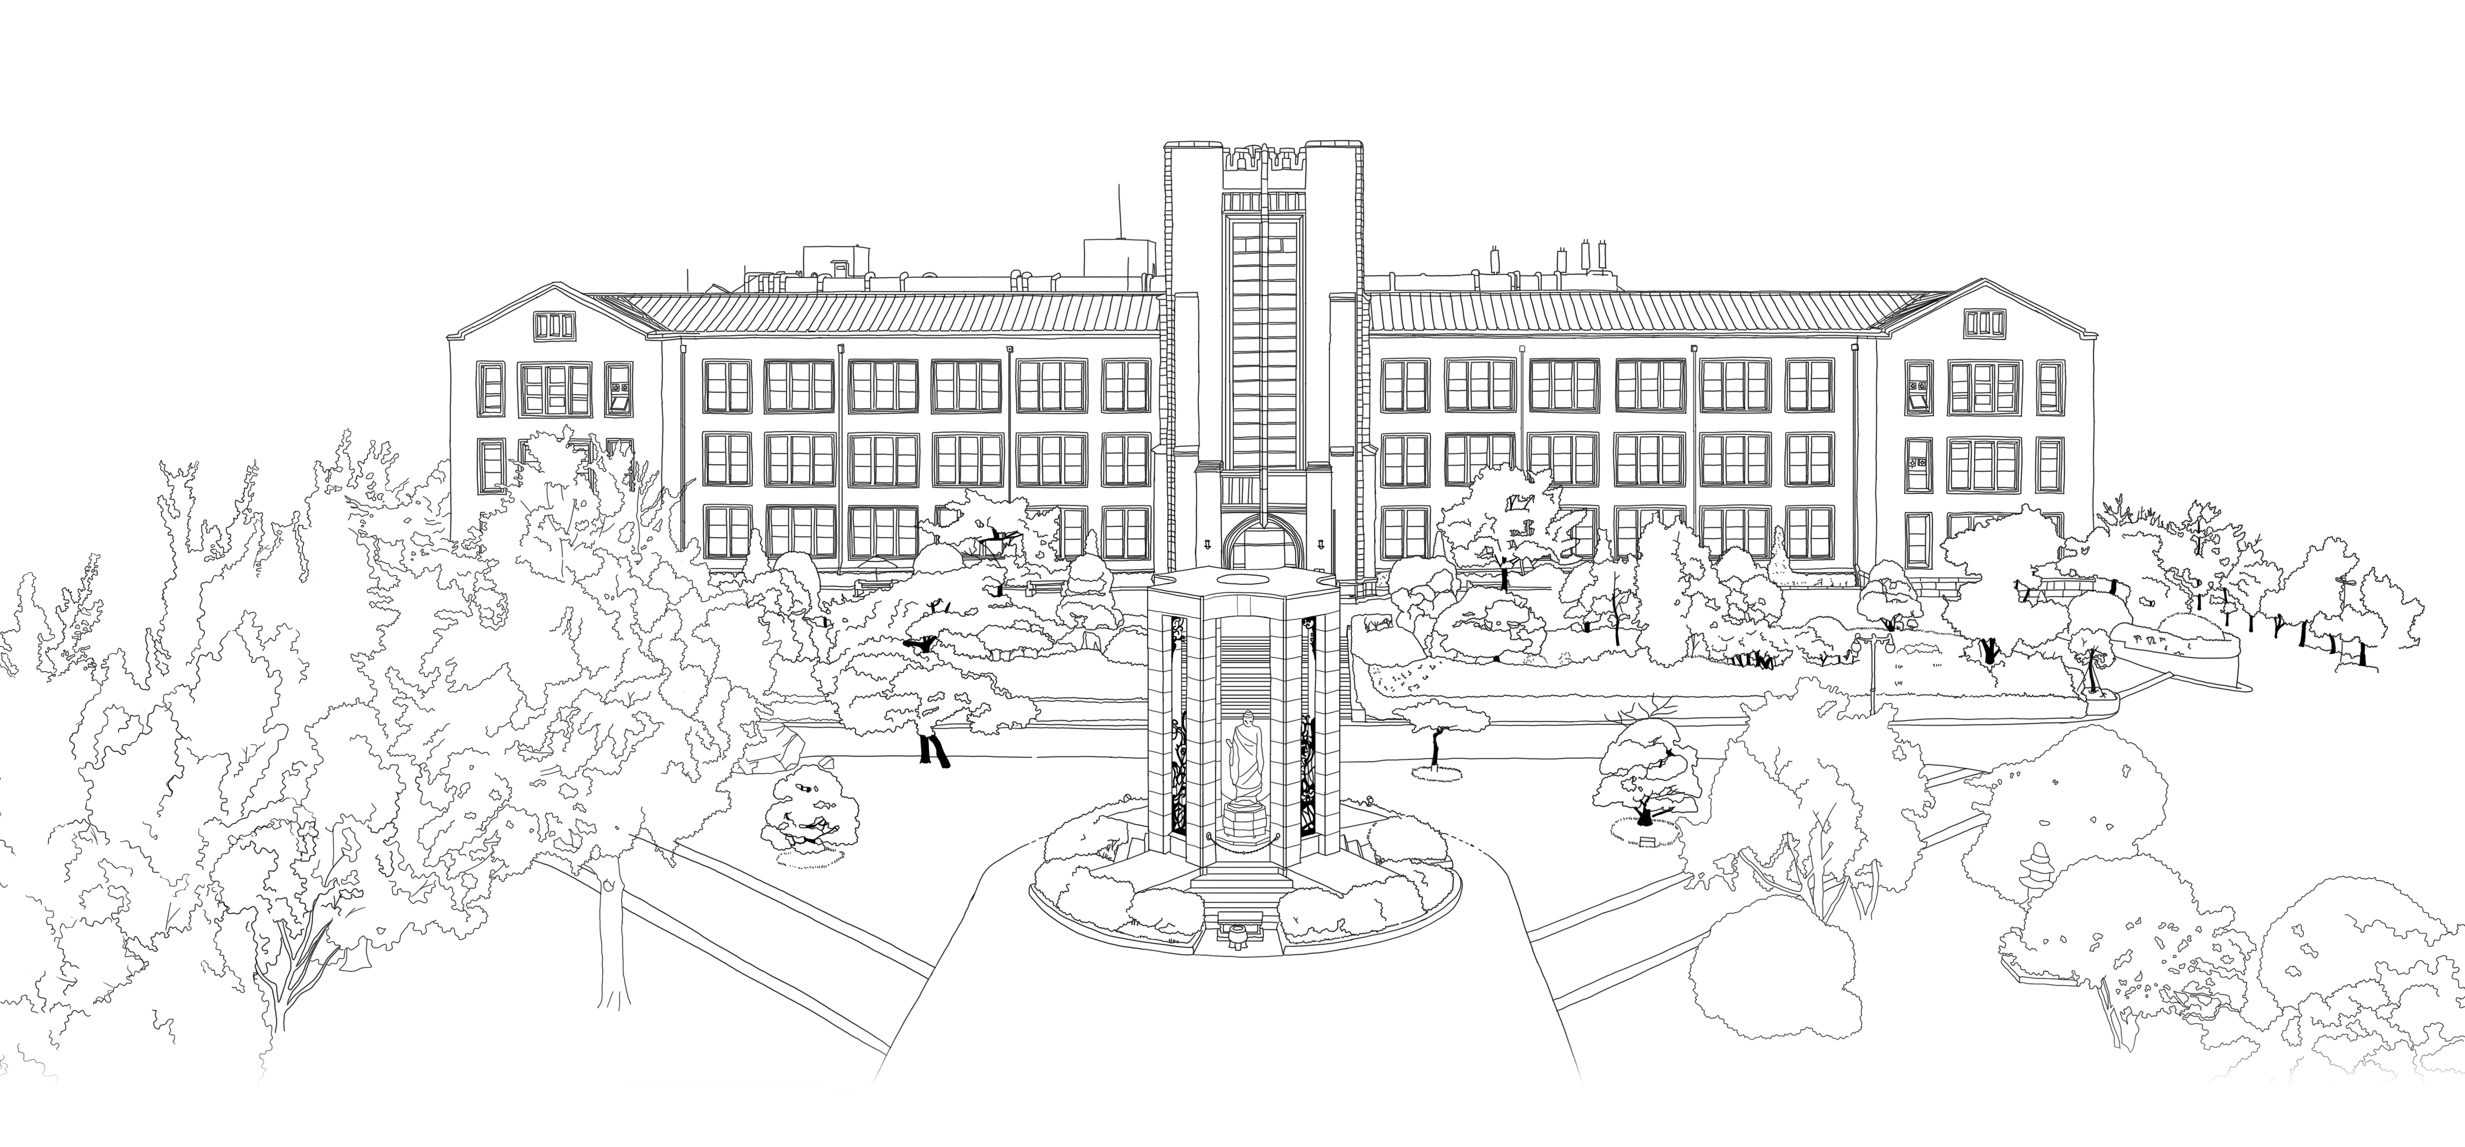


Feature Denoising for Improving Adversarial Robustness
C.Xie, Y.wu, L.maaten, AL.Yuille “Feature Denoising for Improving Adversarial Robustness” CVPR, 2019, pp. 501-509.
DongYeon Kim
Department of Multimedia Engineering
Dongguk University
Notes:
goodmorning, everyone.
I will present the paper, titled “Feature Denoising for Improving Adversarial Robustness”.
It was published on CVPR in two thousand nineteen.

Slide 2
Contents
Introduction
Related Work
Proposed Method
Experimental Results
Conclusion
Notes:
The table of contents is as follows.
I will present in order of Introduction, Related Works, Proposed Method, Experimental Results, and Conclusion

Slide 3
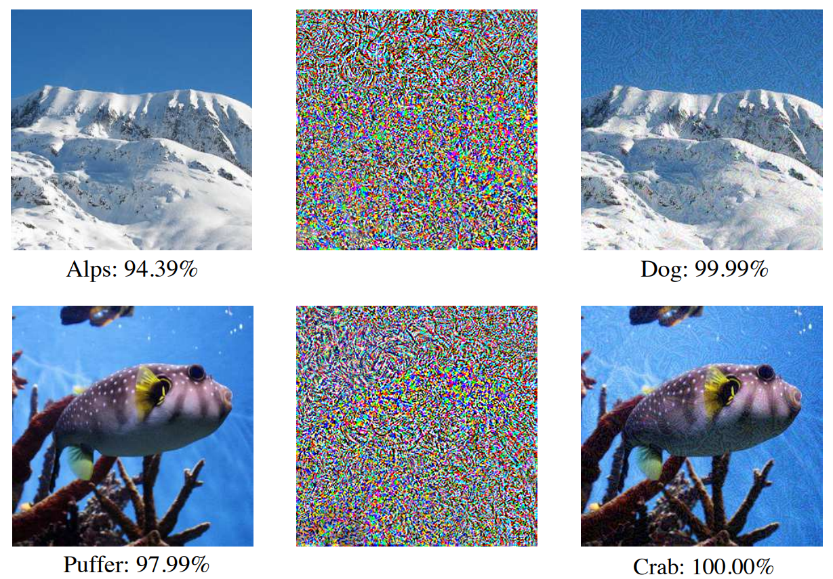
Introduction
Adversarial attack
Definition of adversarial attack
add small perturbations to images that lead classification systems into making incorrect prediction
Perturbations are imperceptible or perceived as small noise in the image
effective against convolutional network
Demonstrate that networks perform computations that are dramatically different from those in human brain
[1]
Original image
perturbation
Perturbed image
Original image
perturbation
Perturbed image
[1]
K. Dabo, A. Foi, V. Katkovnik, and K. Egiazarian. Image denoising by sparse 3-d transform-domain collaborative filtering. TIP, 16(8):2080–2095, 2007..
Notes:
At first, I’ll introduce the concept of Adversarial attack.
Adversarial attacks to image classification systems add small perturbations to images that lead these systems into making incorrect prediction
While the perturbations are imperceptible or perceived as small noise in the image, these attacks are highly critical to successful convolutional network
Look at these six images
The leftmost image is recognized by some convolutional network as puffer with about ninety-eight percentage accuracy.
In the second image, a perturbation such as small noise is added to the original image.
Because It is not recognized by human eye system, it can be predicted that it is a puffer by looking at the third perturbed image.
However, contrary to our predictions, the same convolutional network predicts that the third image is crab with 100% accuracy
Similar with the first image set, in the second image set,
Some cnn model predicts first mountain image as alps with ninety-four percentage accuracy.
But after adding some perturbation to the image, the same model predict perturbed image as a dog with about 100% accuracy
This result demonstrate that networks perform computations that are dramatically different from those in human brain.

Slide 4
Introduction
Adversarial attack
Type of adversarial attack
White-box attack
The attacker knows all the information about the network architecture (all parameters)
Attack the network based on the gradient of the network loss function (maximize loss)
Hard to defense
Black-box attack
The attacker attacks without knowing the information on the model
Only observe the network output on some inputs
Attack the network based on greedy local search on the actual gradient
Relatively easy to defense
Notes:
The adversarial attack described above is largely classified into two types.
The First type is white-box attack.
In the white box attack, the attacker knows all the information about the network architecture including all parameters in network.
So the attacker can attack the convolutional network based on the gradient of the network loss function by maximizing the loss.
This is learned contrary to what we aim for. Therefore, it is very critical to the network and it is hard to defense.
The second type is black-box attack
In the black box attack, the attacker doesn’t knows the information about the network architecture.
So the attacker only observe the network output on some inputs, and then attack the network based on greedy local search on the actual gradient.
Compared to white-box, it is relatively easy to defense

Slide 5
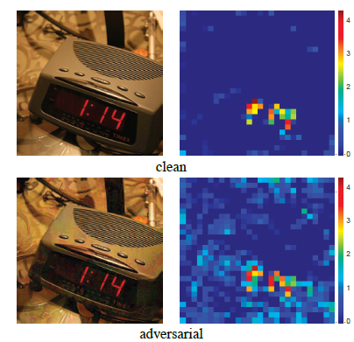
Introduction
Motivation
Feature Map
Randomly selected feature map of a ResNet architecture
Clean image feature map (left image)
features appear to focus primarily on semantically informative content in the image
Adversarially perturbed counterpart (right image)
Adversarial perturbations are small in the pixel space
Perturbations are substantial noise in the feature maps of the network
Features are activated across irrelevant regions
Notes:
Now, I will explain the effect of perturbations on feature map of the network.
The image on the right side of each picture above shows a randomly selected feature map of a ResNet architecture.
The image pair on the left is clean image and its feature map.
When we look at the feature map of clean image, the features appear to focus primarily on semantically informative content in the image.
In this case, around the digital clock object.
On the other hand, the image pair on the right is perturbed image and its feature map.
When we look at the perturbed image, the adversarial perturbations are small in the pixel space, so we can not perceive well this noise.
But when we look at the feature map image, we can find that the perturbations are substantial noise in the feature maps of the network.
And also, features are activated across semantically across irrelevant regions like background of image.

Slide 6
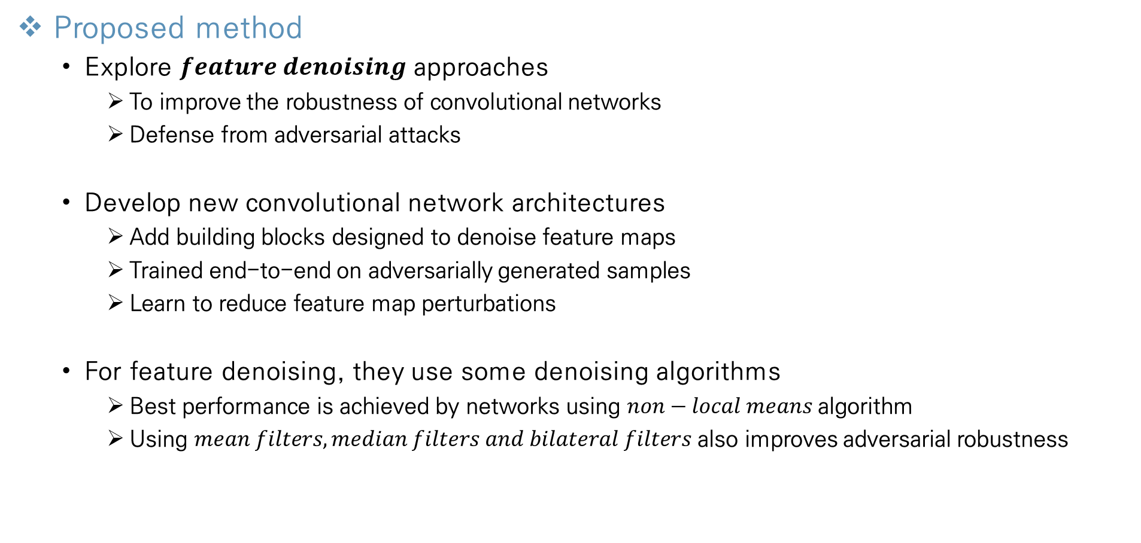
Introduction
Proposed method
Explore $feature denoising$ approaches
To improve the robustness of convolutional networks
Defense from adversarial attacks
Develop new convolutional network architectures
Add building blocks designed to denoise feature maps
Trained end-to-end on adversarially generated samples
Learn to reduce feature map perturbations
For feature denoising, they use some denoising algorithms
Best performance is achieved by networks using $non−local means$algorithm
Using $mean filters, median filters and bilateral filters$ also improves adversarial robustness
Notes:
Motivated by the characteristics of the adversarial attack described above, and its effect on convolutional network, the author proposes the following method.
They explore feature denoising approaches to improve the robustness of convolutional networks against adversarial attacks.
They develop new convolutional network architectures by adding building blocks designed to denoise feature map.
And the network models are trained end to end on adversarially generated samples.
They call this procedure as adversarial training.
By using this training method, the model learns to reduce feature map perturbations.
In the last, in denoising blocks of network architecture, they use some denoising algorithms
In this paper, according to the experimental results, the best performance is achieved by using non-local means algorithm.
And using mean filters, median filters and bilateral filters also improves the adversarial robustness of the convolutional network against adversarial attack.

Slide 7
Related Works
Adversarial training methods
Adversarial logit paring (ALP)
A type of adversarial training
Encourage the logit prediction of a network for a clean image
Weaken the logit prediction for the adversarial image
Use high-level features to guide the pixel denoiser
Denoising is applied directly on pixel
Transform the images via non-differentiable image preprocessing
using image quilting, total variance minimization, quantization
[2]
[3]
[4]
→ these defenses may be effective in black-box settings, can be circumvented in white-box settings
→ proposed models are able to improve adversarial robustness against strong white-box attacks
[2]
H. Kannan, A. Kurakin, and I. Goodfellow. Adversarial logit pairing. arXiv preprint arXiv:1803.06373, 2018.
[3]
F. Liao, M. Liang, Y. Dong, and T. Pang. Defense against adversarial attacks using high-level representation guided denoiser. In CVPR, 2018.
[4]
C. Guo, M. Rana, M. Cisse, and L. van der Maaten. Countering adversarial images using input transformations. In ICLR, 2018.
Notes:
Before introducing the proposed method, I’ll introduce three related works in this page.
The first related method is Adversarial logit paring called ALP.
It is a type of adversarial training that encourages the logit prediction of a network for a clean image.
But it weaken the logit prediction for the adversarial image.
The second related method is using high-level features to guide the pixel denoiser can denoise well.
This methods are only applied directly on pixel level.
The last related method is to transform the images via non-differentiable image preprocessing.
It uses the image guilting, total variance minimization, and quantization method.
These three defense method are effective only in black-box settings, but can be vulnerable in white-box settings.
But the author’s proposed models are still able to improve adversarial robustness against very strong white-box attacks.

Slide 8
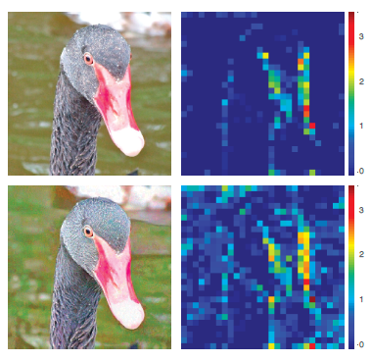
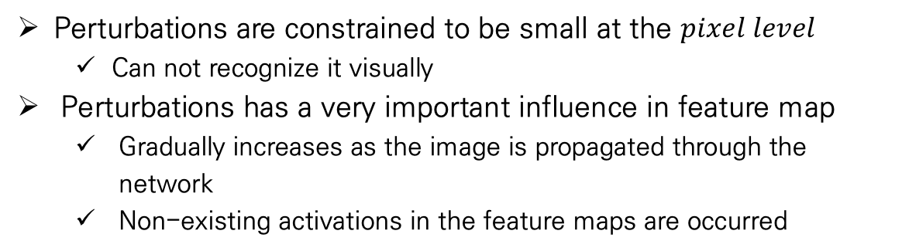
Proposed Method
Feature Noise
Adversarial image
definition
Noisy image that is created by adding perturbations to image
Perturbations are imperceptible by humans or perceived as very small noise
pixel map
feature map
Perturbations are constrained to be small at the $pixel level$
Can not recognize it visually
Perturbations has a very important influence in feature map
Gradually increases as the image is propagated through the network
Non-existing activations in the feature maps are occurred
clean
adversarial
→ if the wrong activations overwhelm the true signal, the network makes wrong predictions
non-existing activations are hallucinated
Notes:
From this page, I will introduce about the proposed methods.
Before explaining the proposed methods in detail, we have to know the characteristic of adversarial image and feature noise
This is the definition of adversarial image
The adversarial images are created by adding perturbations to images.
The perturbations are assumed to be either imperceptible by humans, or perceived as noise that doesn’t impede human recognition of the visual content.
Perturbations are constrained to be small at the pixel level according to a certain norm.
So we can not recognize well it visually.
In the adversarial image on the left, we don’t perceive noise, so we can know that it is a duck image.
But perturbations has a very important influence in feature map of convolutional network.
It is gradually increases as the image is propagated through the network.
And non-existing activations in the feature maps are hallucinated.
In other words, the transformation performed by the layers in the network aggravate the perturbation, and the hallucinated activations can overwhelm the true signal activations.
If the wrong activations overwhelm the true signal, the network makes wrong predictions.

Slide 9
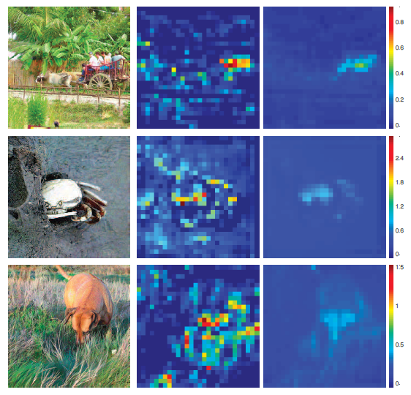
Proposed Method
Feature Noise
Feature denoising
The authors attempt to address this problem by feature denoising
Using feature denoising operations
Successfully suppress the noise in the feature map
Make the responses focus on meaningful content
Add a denoising block in the network + end-to-end train
Change the magnitudes and distributions of all features
Make the model reduce the noisr in feature map
adversarial
feature map
denoised
Notes:
So in this study, the authors attempt to address this problem by feature denoising.
In the figure, the leftmost image is adversarial image.
the middle is the feature map of adversarial image, and the rightmost image is the result image after the feature denoising operation.
The figure shows that by using feature denoising operations, they can successfully suppress the noise in the feature map.
And make the responses focus on visually meaningful content.
And the author add a denoising block in the network and then ene-to-end train the network.
It can change the magnitudes and distributions of all features and make the model reduce the noise in feature map.

Slide 10
Proposed Method
Denoising Feature Maps
Introduction
Add denoising blocks at intermediate layers of convolutional networks
Improve adversarial robustness
The denoising blocks are trained jointly with all layers of the network
in an end-to-end manner using adversarial training
Eliminate feature map noise generated by the attacker
The best-performed denoising blocks are inspired by non-local networks
Focus on the design of denoising blocks and denoising effect!
Notes:
Now I will explain how to denoise the feature maps of the convolutional network.
They propose to improve adversarial robustness by adding denoising block at intermediate layers of convolutional networks.
They add several blocks to the network, and then they are trained jointly with all layers of the network.
We call this procedure as an end-to-end manner.
And they also use adversarial training method which is training with perturbed image, and makes the model predict the perturbed image correctly.
In the denoising block combined with network’s layer, they design the denoising blocks, and then the best-performed blocks are inspired by non-local networks.
So now we will focus on the design of denoising blocks and the denoising effect.

Slide 11
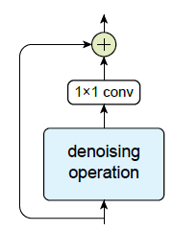
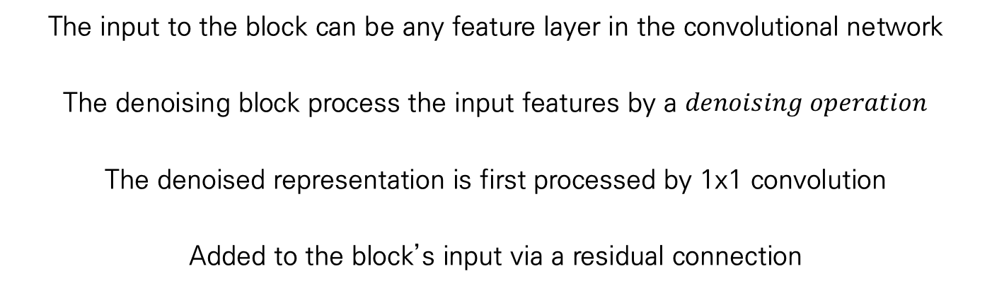
Proposed Method
Denoising Feature Maps
Denoising Block
The procedure in denoising block
The input to the block can be any feature layer in the convolutional network
The denoising block process the input features by a $denoising operation$
The denoised representation is first processed by 1x1 convolution
Added to the block’s input via a residual connection
A generic
denoising block
Notes:
Now I will explain about the procedure in denoising block.
The left figure represents a generic denoising block which is combined with network layer.
Therefore the input to the block can be any feature layer in the convolutional network.
And then the denoising block process the input feature by a denoising operations.
In the denoising operation box, the feature maps are denoised by several denoised algorithms, such as non-local means or other variants.
After denoising, the denoised representation is first processed by a 1x1 convolutional layer.
And then it is added to the block’s input via a residual connection.
And this result propagated to next layer.

Slide 12
Proposed Method
Denoising Feature Maps
Denoising Block
Denoising operation in denoising block is actually doing the denoising
1x1 convolution & residual connection are mainly for feature combination
1x1 convolution
Control the number of channels of denoised output
Adjust the tradeoff between removing noise and retaining signal
Residual connection
Various operations can suppress noise, but also impact signal
Add denoised output to the original input value
Can help the network to retain signals
1x1 convolution
Residual connection
A generic
denoising block
Notes:
In the denoising block, we adopt the 1x1 convolution layer to the denoised representation and used residual connection.
But both procedure is not about the denoising process, the denoising operation in denoising block is actually doing the denoising.
1x1 convolution and residual connection are mainly for feature combination.
By using 1x1 convolution, we can control the number of channels of denoised output.
And when the denoised output is combined with the original signal, this convolution process can adjust the tradeoff between removing noise and retaining signal.
When we suppress feature noise using various denoising algorithm, they can also impact important signal.
Therefore the usage of the residual connection can help the network to retain signals.
Because it makes denoised output be added to the original input value.

Slide 13
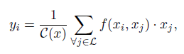
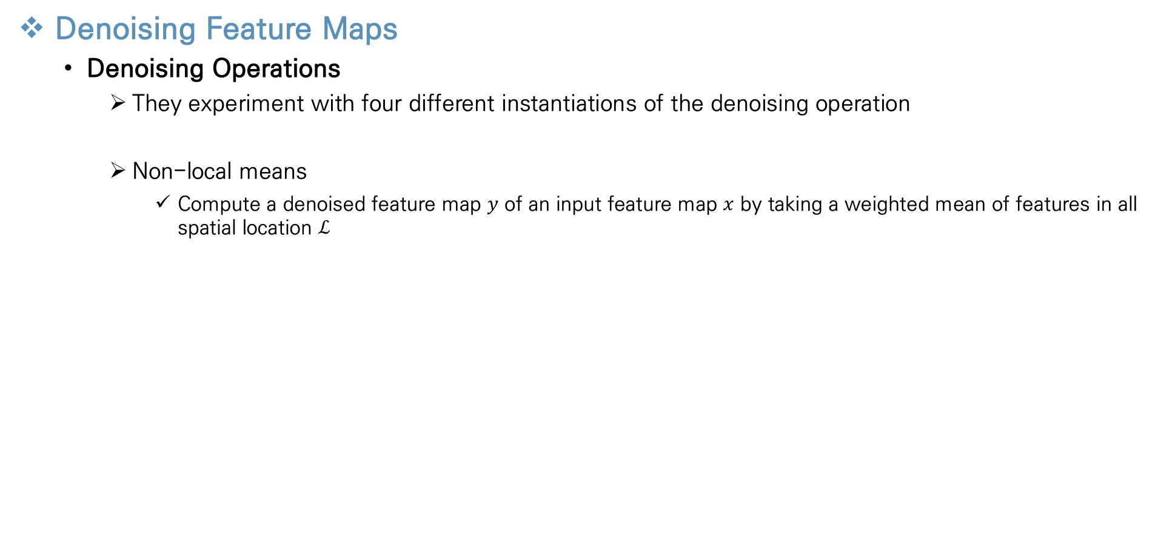
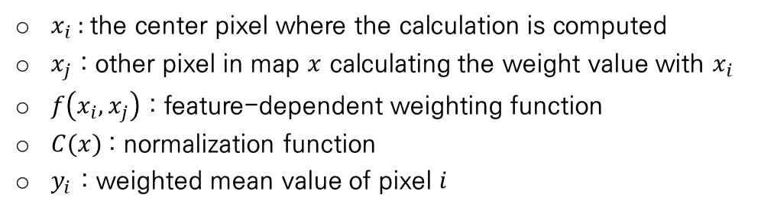
Proposed Method
Denoising Feature Maps
Denoising Operations
They experiment with four different instantiations of the denoising operation
Non-local means
Compute a denoised feature map $y$ of an input feature map $x$ by taking a weighted mean of features in all spatial location $ℒ$
$x_{i}$ : the center pixel where the calculation is computed
$x_{j}$ : other pixel in map $x$ calculating the weight value with $x_{i}$
$f\left(x_{i},x_{j}\right)$ : feature-dependent weighting function
$C(x)$: normalization function
$y_{i}$ : weighted mean value of pixel $i$
Notes:
From now, I’ll explain several denoising operations, which are the most important part in the denoising block
In this paper, the authors experiment with four different instantiations of the denoising operation
The first denoising operation is the non-local means that performed best in the experimental results.
In the non-local means algorithm, we compute a denoised feature map y of an input feature map x, by taking a weighted mean of features in all spatial location L.
For each pixel xi in the feature map x, it computes the weight value according to other pixel xj in the feature map x.
The more xj has a value similar to xi, the greater the weight value with xi
To compute yi value, The weight with xi and all other pixels in feature map x represented xj are calculated and then find the total average value.
This formula represents the non-local means algorithm.
As I mentioned before, xi represent the center pixel where the calculation is computed.
xj is other pixel in feature map x, calculating the weight value with xi.
F(xi, xj) represent the feature dependent weighting function equals to weight value between xi and 터.
C(x) represent the normalization function to find mean value.
And the last, yi represent the weighted non-local mean value of pixel I.
Therefore, we can compute denoised feature map by calculating this formula to all of the pixel in feature map x.

Slide 14
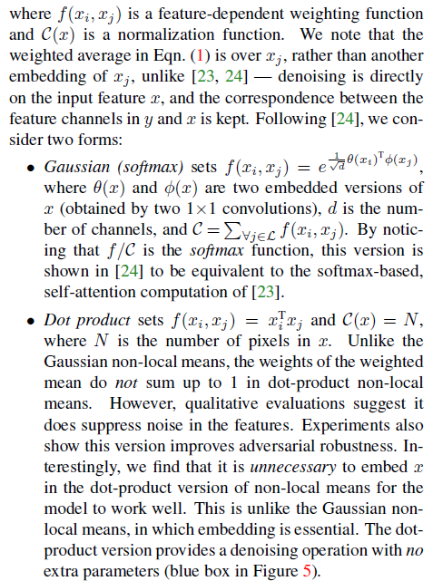
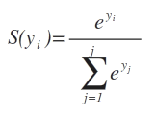
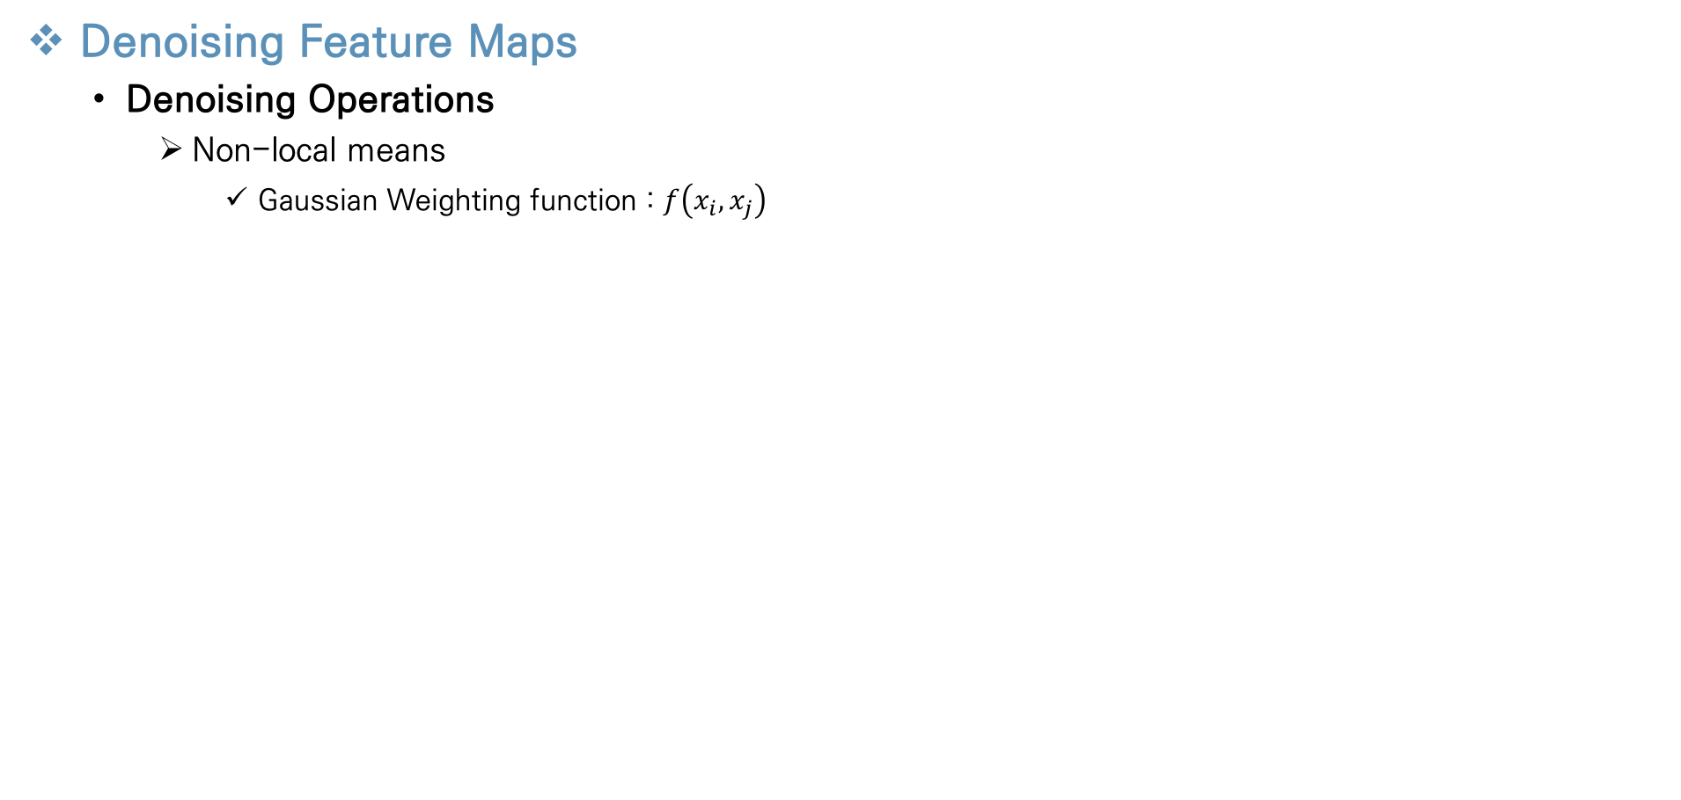
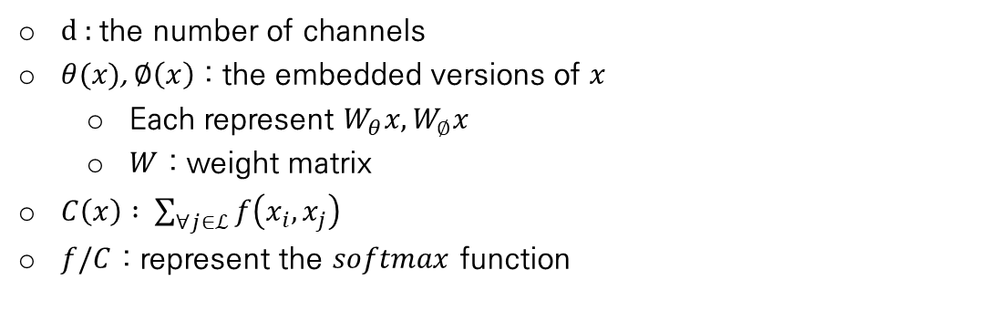
Proposed Method
Denoising Feature Maps
Denoising Operations
Non-local means
Gaussian Weighting function : $f\left(x_{i},x_{j}\right)$
d : the number of channels
$θ(x)$, $∅\left(x\right)$ : the embedded versions of $x$
Each represent $W_{θ}x,W_{∅}x$
$W$ : weight matrix
$C\left(x\right) : \sum_{∀j∈ℒ}{f\left(x_{i},x_{j}\right)}$
$f/C$ : represent the $softmax$ function
→ equation equal about $softmax function :softmax(x^{T}W_{θ}^{T}W_{∅}^{}x)x$
Notes:
In this page I’ll introduce more detail about the non-local means formula.
In the formula, we don’t know how to compute the feature-dependent weighting function, f(xi, xj)
In this paper, they introduce two method, gaussian weighting function and dot product weighting function.
In this page, I’ll explain the gaussian weighting function.
The feature-dependent weighting function f is defined as a gaussian function like this formula (두번째 수식 가르키기)
In this formula, the value d represent the number of channels.
Theta(x) and pie(x) represent the embedded version of x in gaussian function, which means the expanded concept.
Theta(x) and pie(x) represent $W_{θ}x,W_{∅}x$and the value W represent weight matrix that contains the trainable value.
The function c(x) is the normalization function, so it represent the summation of function f value for all pixel j with pixel i
In this formation, we can find important transformation.
When we divide weighting function f by normalization function C, we can know that it is equal to the softmax function.
The definition of softmax function is like this form (소프트맥스 함수 가르키기)
Therefore, the non-local mean formula can be converted into an equation for softmaxfunction.
Like $softmax(x^{T}W_{θ}^{T}W_{∅}^{}x)x$

Slide 15
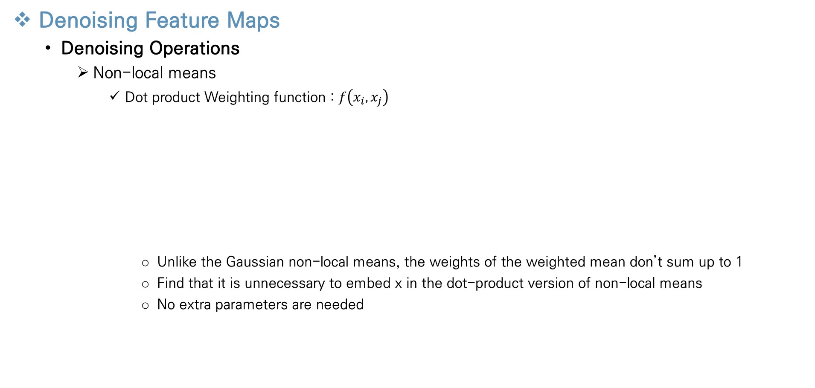
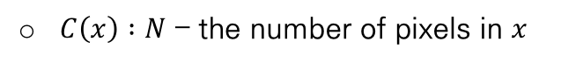
Proposed Method
Denoising Feature Maps
Denoising Operations
Non-local means
Dot product Weighting function : $f\left(x_{i},x_{j}\right)$
Unlike the Gaussian non-local means, the weights of the weighted mean don’t sum up to 1
Find that it is unnecessary to embed x in the dot-product version of non-local means
No extra parameters are needed
$C\left(x\right) :N$ – the number of pixels in $x$
Notes:
For next, I will explain about the second weighting function called dot product.
In dot product weighting function, it is simply defined as the dot product of those two vector.
In this formula the normalization function C(x) represent the number of pixels in x.
Unlike the gaussian non-locan means, the weights of the weighted mean don’t sum up to 1.
Because it just compute the product of vector.
as originally, the function is defined using embed x, so the function f is theta(xi)transform pie(xj)
But the author find that it is unnecessary to embed x in the dot-product version of non-local means according to several experiments
Therefore this method doesn’t need extra parameters.

Slide 16
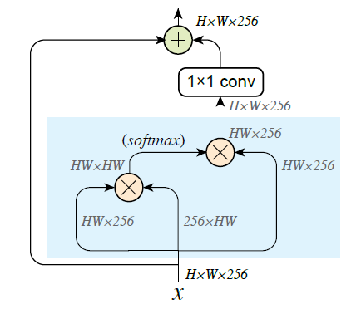
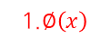
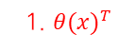
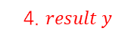

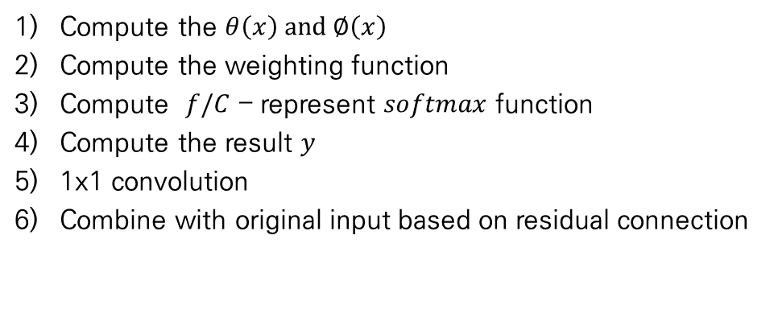
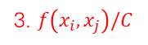
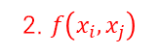
Proposed Method
Denoising Feature Maps
Denoising Operations
Non-local means : Revised denoising block
Use non-local means as a denoising operation
6. Residual connection
5. 1x1 convolution
Compute the $θ\left(x\right)$ and $∅\left(x\right)$
Compute the weighting function
Compute $f/C$ – represent $softmax$ function
Compute the result $y$
1x1 convolution
Combine with original input based on residual connection
3. $f\left(x_{i},x_{j}\right)/C$
4. $result y$
2. $f\left(x_{i},x_{j}\right)$
4. $x$
1. $θ(x)^{T}$
1.$∅\left(x\right)$
Notes:
By using non-local means algorithm as the denoising operations of the denoising block,
We can revise the generic denoising block according to the gaussian non-local means procedure.
The procedure on the sky blue background represents the denoising operation part
0. as an input of the block, previous layer’s feature max x is propagated, and its dimension is Height by width by channel 256
At first step, we compute the theta$\left(x\right)transform$ and $pie\left(x\right)$, the left direction is the theta$\left(x\right)transform$, and the right direction is the $pie\left(x\right)$.
And then we compute the gaussian weighting function f(xi, xj)
At third step we compute function f over normalization function c which represent the softmax function
At fourth step, compute result y by multiplinh value x and result of step 3
And then processed by 1x1 convolution to adjust the tradeoff between original signal
And the last the final denoised feature representation is combined with original signal x according to the residual connection.
As I mentioned before, it is due to retain important signal

Slide 17
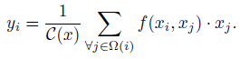
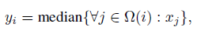
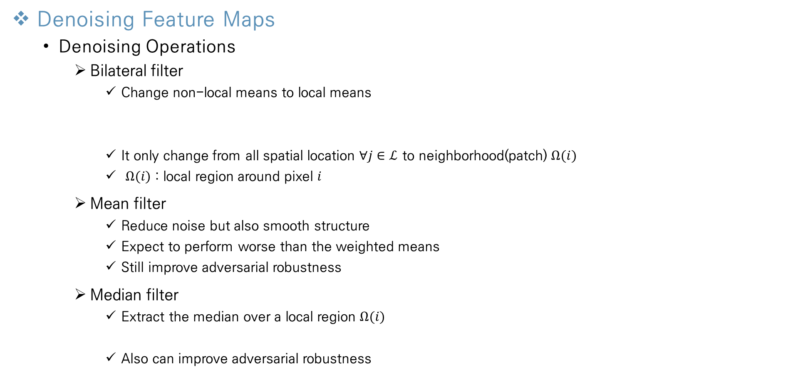
Proposed Method
Denoising Feature Maps
Denoising Operations
Bilateral filter
Change non-local means to local means
It only change from all spatial location $∀j∈ℒ$ to neighborhood(patch) $Ω(i)$
$Ω(i)$ : local region around pixel $i$
Mean filter
Reduce noise but also smooth structure
Expect to perform worse than the weighted means
Still improve adversarial robustness
Median filter
Extract the median over a local region $Ω(i)$
Also can improve adversarial robustness
Notes:
So far, I have explained the non-local means algorithm as the denoising operations. Because this algorithm has the best performance according to the experimental results.
But in this paper, the authors use other denoising operations, and these methods also have a good performance.
First algorithm is Bilateral filter.
It is easy to know because we already studied the non-local means.
Bilateral filter is to change non-local means to local means.
It only change from all spatial location all of j contained to entire location L to neighborhood $omega\left(i\right)$
Omega(i) represents the local region patch around pixel I
Second algorithm is mean filter
It reduce noise well, but also smooth the structure, so we expect to perform worse than the weighted means.
But this algorithm also still improve the adversarial robustness of the network.
The last algorithm is Median filter
This algorithm rarely use in network architecture.
It extracts the median over a local region omega(i). So it is represented like this formula(수식 가리키기)
This algorithm is well performed in salt and pepper type of noise, but also can improve advserarial robustness according to the experimental results.

Slide 18
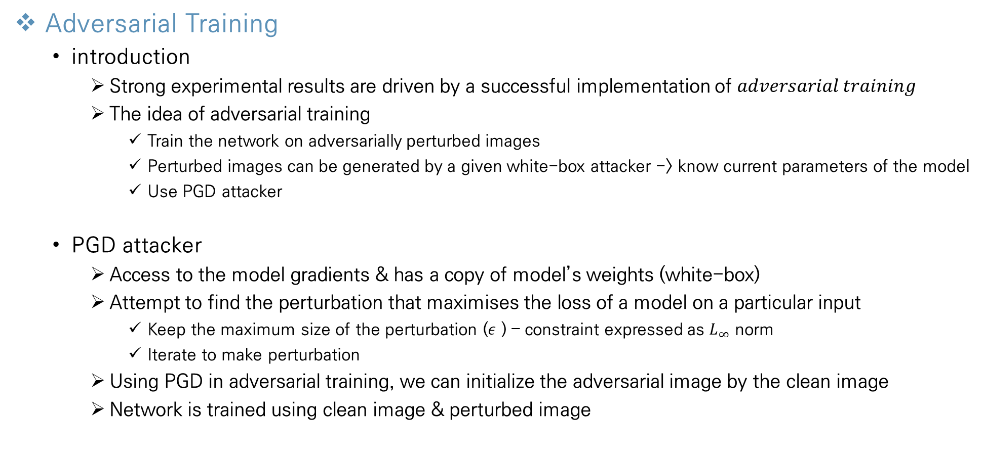
Proposed Method
Adversarial Training
introduction
Strong experimental results are driven by a successful implementation of $adversarial training$
The idea of adversarial training
Train the network on adversarially perturbed images
Perturbed images can be generated by a given white-box attacker -> know current parameters of the model
Use PGD attacker
PGD attacker
Access to the model gradients & has a copy of model’s weights (white-box)
Attempt to find the perturbation that maximises the loss of a model on a particular input
Keep the maximum size of the perturbation ($ε$ ) – constraint expressed as $L_{∞}$ norm
Iterate to make perturbation
Using PGD in adversarial training, we can initialize the adversarial image by the clean image
Network is trained using clean image & perturbed image
[5]
[5]
A. Madry, A. Makelov, L. Schmidt, D. Tsipras, and A. Vladu. Towards deep learning models resistant to adversarial attacks. In ICLR, 2018.
Notes:
This is the last part of proposed method.
So far, we design the denoising block and select denoising operations and add this blocks to the networks layer.
Author also combine the adversarial Training method to defense from the adversarial attack.
This training method also important, because strong experimental results are driven by a successful implementation of adversarial training.
The basic idea of adversarial training is like this.
We train the network on adversarially perturbed image to predict perturbed image well.
We don’t have perturbed image, but we can make this image, because by a given white-box attacker, we can generate perturbed images.
We know all of the current parameters of the model.
To make these perturbed images, we use Projected Gradient Desecne called PGD.
To make perturbed image, PGD attacker access to the model gradients and has a copy of model’s weights.
Since It is a white-box attacker, it can access to the model and copy all of the parameters.
And then it attempts to find the perturbations that maximises the loss of the model on a particular input.
Normally the networks are trained to minimize the loss of the model’s loss function, but the PGD attacker works inversely.
It keeps the maximum size of the perturbation epsilon per pixel, and this constraint expressed as L_infinity norm.
The perturbation value of pixel can’t be bigger or smaller than the value epsilon
And PGD iterate to make perturbation stronger.
By using this PGD attacker in adversarial training, we can initialize the adversarial image by the clean image.
And the network is trained with clean image and created perturbed image by PGD attacker.

Slide 19
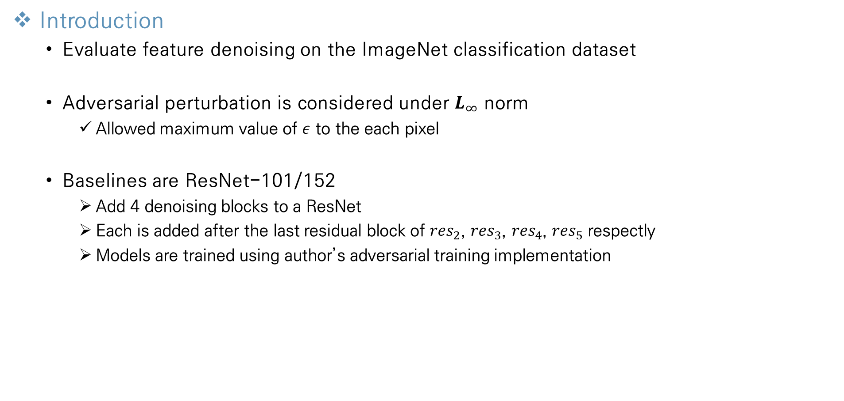
Experimental Results
Introduction
Evaluate feature denoising on the ImageNet classification dataset
Adversarial perturbation is considered under $L_{∞}$ norm
Allowed maximum value of $ε$ to the each pixel
Baselines are ResNet-101/152
Add 4 denoising blocks to a ResNet
Each is added after the last residual block of ${res}_{2}$, ${res}_{3}$, ${res}_{4}$, ${res}_{5}$ respectly
Models are trained using author’s adversarial training implementation
Notes:
From this page I will introduce about experimental results
This is the introduction about the experimental results.
They evaluate feature denoising on the imagenet classification dataset.
And the adversarial perturbation is considered under L_infinity norm.
It allows the maximum value of epsilon to the each pixel
And the last, the baselines of convolutional network architecture are ResNet-101 and ResNet-152.
The author add 4 denoising blocks to each resnet architecture.
Each of denoising block is added after the last residual block of res2, res3, res4 and res5 respectly
All of these models are trained using author’s adversarial training implementation.

Slide 20
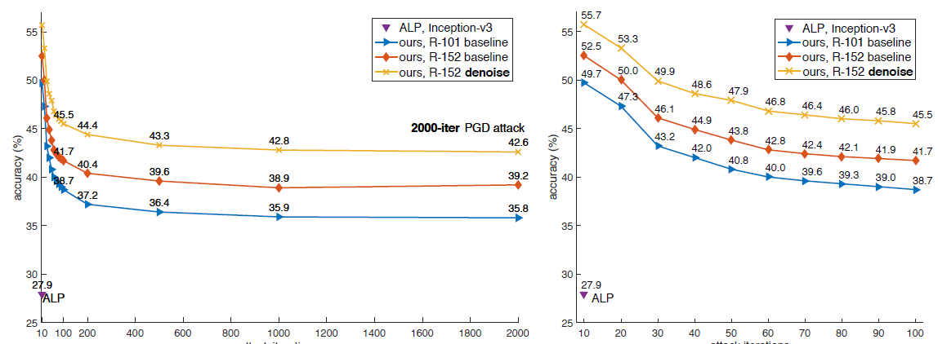
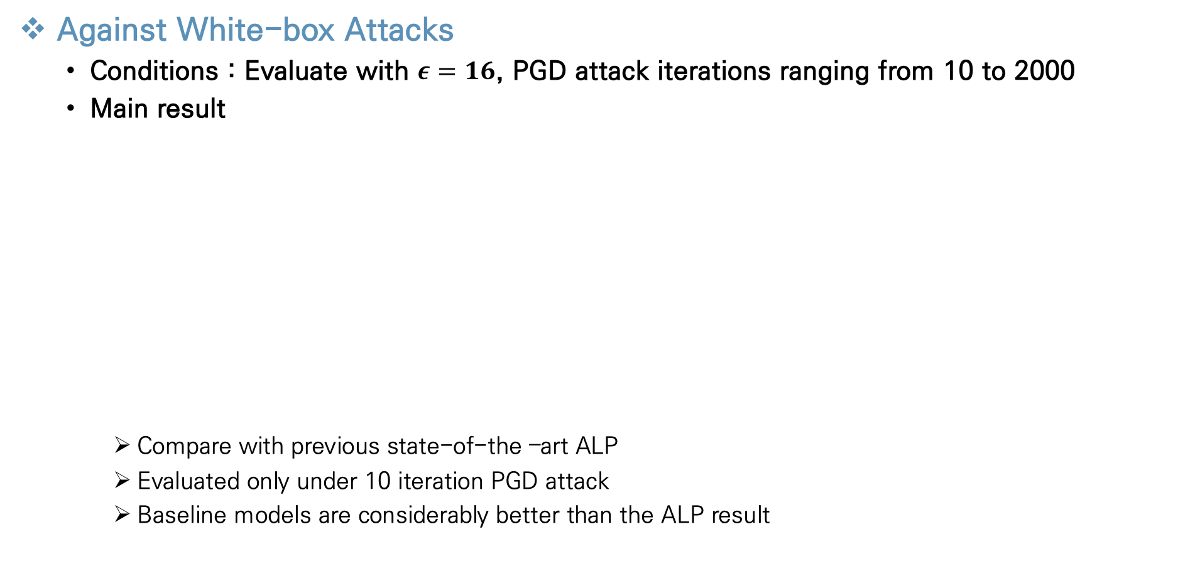
Experimental Results
Against White-box Attacks
Conditions : Evaluate with $ε=16$, PGD attack iterations ranging from 10 to 2000
Main result
Compare with previous state-of-the –art ALP
Evaluated only under 10 iteration PGD attack
Baseline models are considerably better than the ALP result
baseline is very strong
→ Shows that adversarial training system is solid
Notes:
This is the first experiment result.
It is the experiment about white-box attacks.
As basically, they evaluation condition is that eplison value equals 16, and PGD attack iterations ranging from 10 to 2000.
This figure shows the main result.
They first compare with ALP the previous state of the art.
But the ALP was evaluated under 10 iteration PGD attack. And it achieves 27.9% accuracy.
Resnet-101 and Resnet-152 are the baseline models without any denoising blocks trained using adversarial training implementstion.
These baselines are very strong, because it has 49.7% and 52.7% accuracy under 10-iteration PGD attack.
It is considerably better than the ALP result
This result shows that adversarial training system is very important.

Slide 21
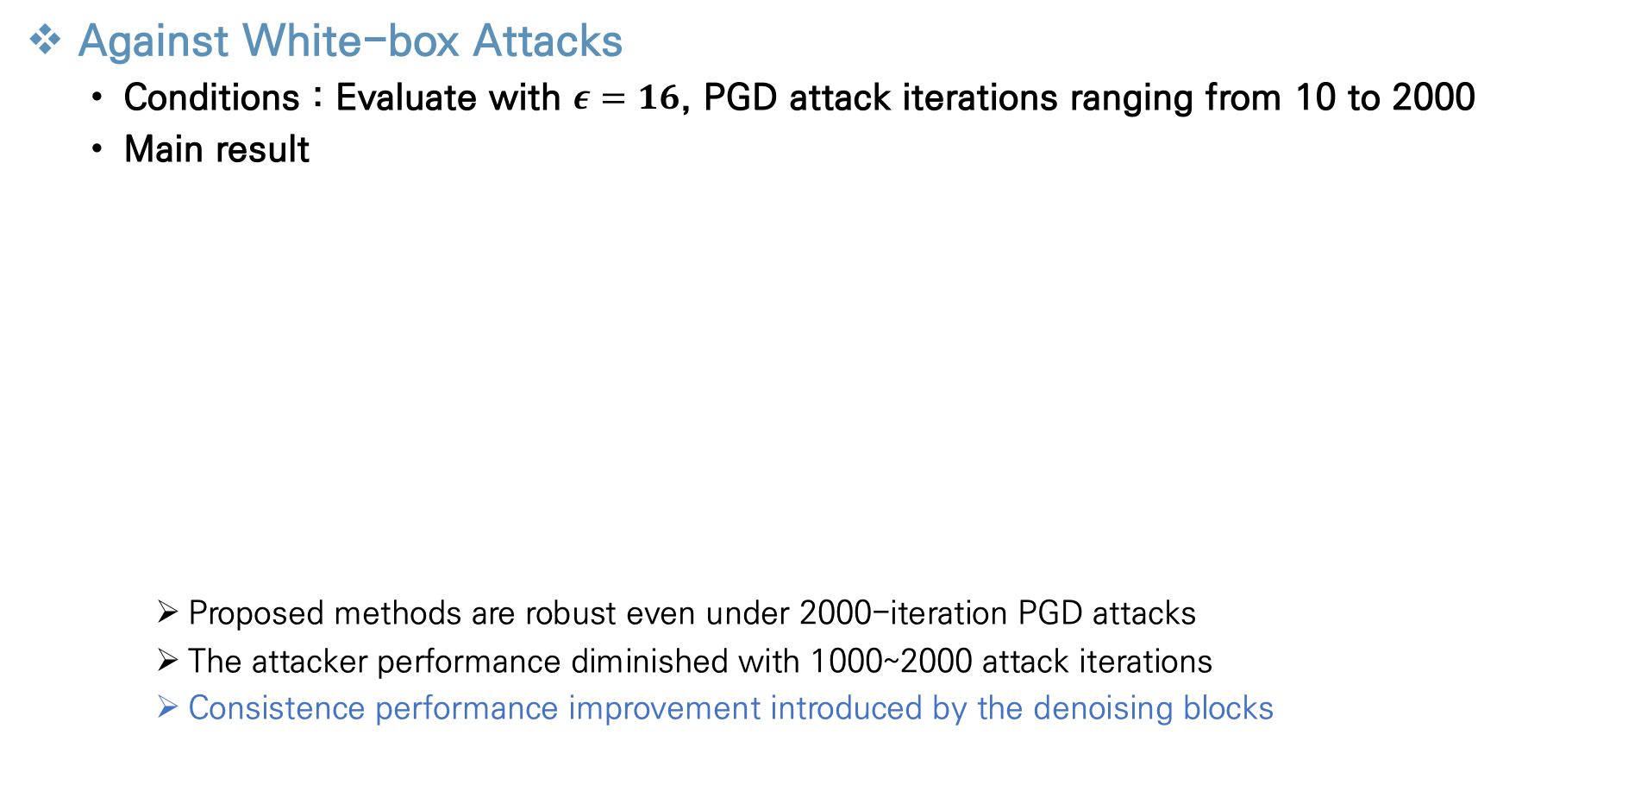
Experimental Results
Against White-box Attacks
Conditions : Evaluate with $ε=16$, PGD attack iterations ranging from 10 to 2000
Main result
Proposed methods are robust even under 2000-iteration PGD attacks
The attacker performance diminished with 1000~2000 attack iterations
Consistence performance improvement introduced by the denoising blocks
Notes:
Now, let’s compare models between baseline models and the proposed model which is added four denoising blocks.
Under the 10-iteration PGD attack, it improves the accuracy of ResNet-152 baseline by 3.2% from 52.5% to 55.7%
It means that the proposed methods are robust even under 2000-iteration PGD attacks
And Such a strong attack has not been previously explored on ImageNet.
Bacause, ALP was only evaluated against 10-iteration PGD attacks.
We can find that the attacker performance diminished with 1000 to 2000 attack iterations and also find that consistence performance improvement introduced by the denoising blocks.

Slide 22
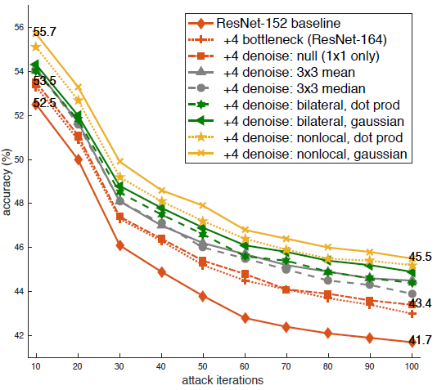
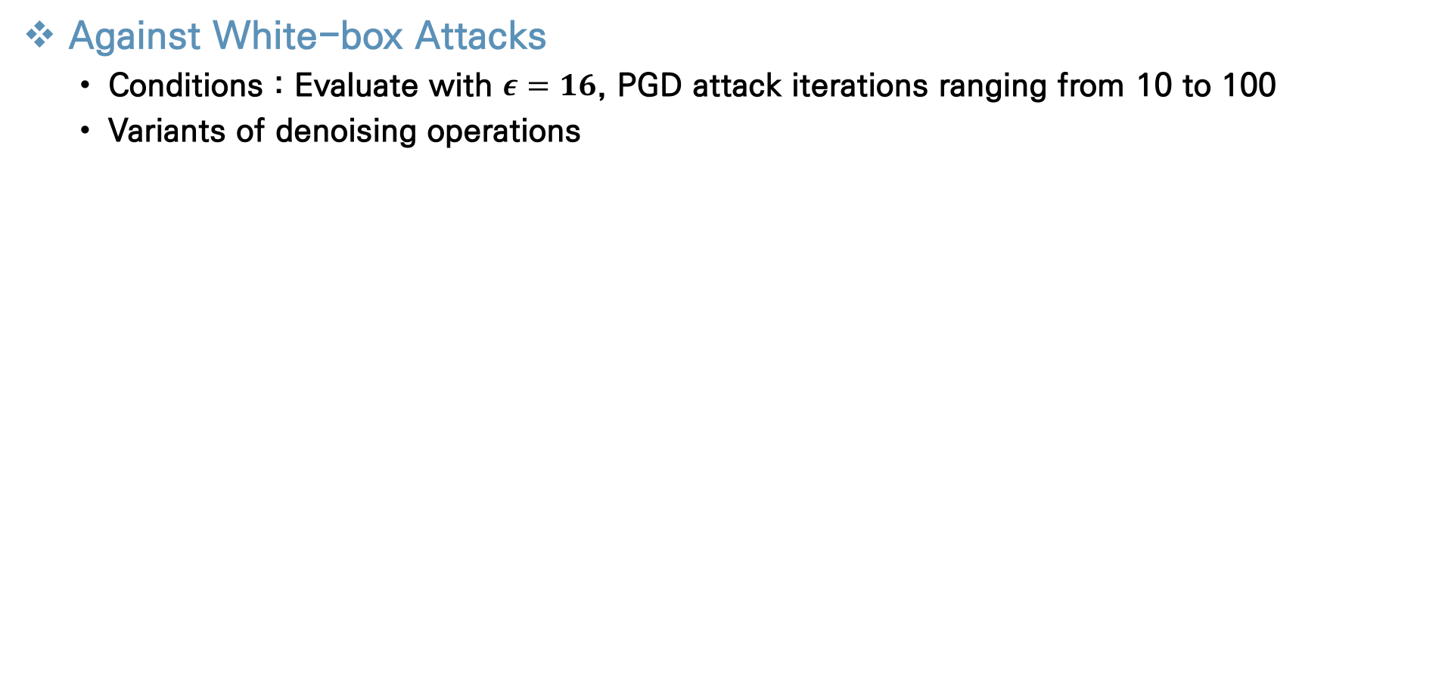
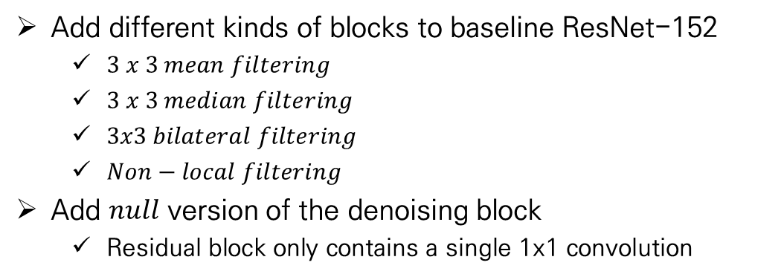
Experimental Results
Against White-box Attacks
Conditions : Evaluate with $ε=16$, PGD attack iterations ranging from 10 to 100
Variants of denoising operations
Add different kinds of blocks to baseline ResNet-152
$3 x 3 mean filtering$
$3 x 3 median filtering$
$3x3 bilateral filtering$
$Non−local filtering$
Add $null$ version of the denoising block
Residual block only contains a single 1x1 convolution
[6]
[6]
K. He, X. Zhang, S. Ren, and J. Sun. Deep residual learning for image recognition. In CVPR, 2016.
Notes:
Next, They evaluate variants of denoising operations, PGD attacker with up to 100 attack iteration
They add different kinds of blocks to baseline ResNet-152, 3x3 mean filter, median filter, bilaterial filter and non – local filter
They also consider a null version of the denoising block.
The block of the generic form becomes a residual block with a single 1x1 convolution

Slide 23

Experimental Results
Against White-box Attacks
Conditions : Evaluate with $ε=16$, PGD attack iterations ranging from 10 to 100
Variants of denoising operations
All of the denoising operations have the better accuracy than 3 baseline model
Show that feature denoising appears to be a useful for adversarial robustness
The best-performing model is the non-local(Gaussian) version
Notes:
All of these denoising operations have better accuracy than Resnet-152 baseline, adding 4 standard bottleneck blocks and adding 4 null denoising blocks.
1x1 null version has the exact same number of extra parameters as the mean filtering, median filtering, bilateral filtering, and non- local filtering’s dot product version.
Because it doesn’t have denoising operation, so it has no extra parameters.
But 1x1 null version has always lower accuracy than other models.
This result represent that feature denoising appears to be a general approach particularly useful for adversarial robustness.
Also their best-performing model is non-local gaussian version.

Slide 24
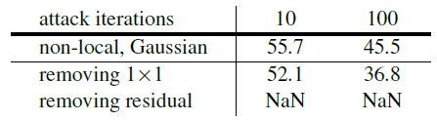
Experimental Results
Against White-box Attacks
Design decisions of the denoising block
The importance of 1x1 convolution & residual connection
The denoising block has a 1x1 layer and a residual connection
Both components do not perform denoising
But important for the denoising blocks to work well
Residual connection
Removing the 1x1 convolution in the denoising block
Accuracy drop considerably
Removing the residual connection
Makes training unstable
Loss does not decrease in adversarial training
→ suggest that denoising features in itself is not sufficient
→ essential to properly combine the denoised features with the original features
Notes:
As I mentioned in the denoising block step, the denoising block always has a 1x1 layer and a residual connection.
But Both components do not perform denoising, they are mainly for feature combination.
For example, 1x1 convolution adjust the trade off between original signal and denoised feature representations and residual connection retain regulate the original signal and denoised signal.
So the author ablate the behavior of the 1x1 convolution and residual connection.
At first, remove 1x1 convolution in the denoising block.
The accuracy drops considerably decreasing from 45.5% to 36.8% under 100-iteration PGD attacks.
Second, they remove the residual connection.
It makes training unstable, and its loss does not decrease in their adversarial training
These results contain very important informations.
First it suggest that denoising features in itself is not sufficient.
It need 1x1 convolution and residual connection procedure.
Second removing noise can also remove the useful signals, so it is essential to properly combine the denoised features with the input features in denoising blocks.

Slide 25
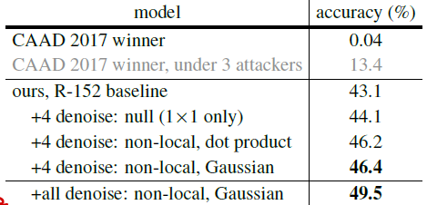
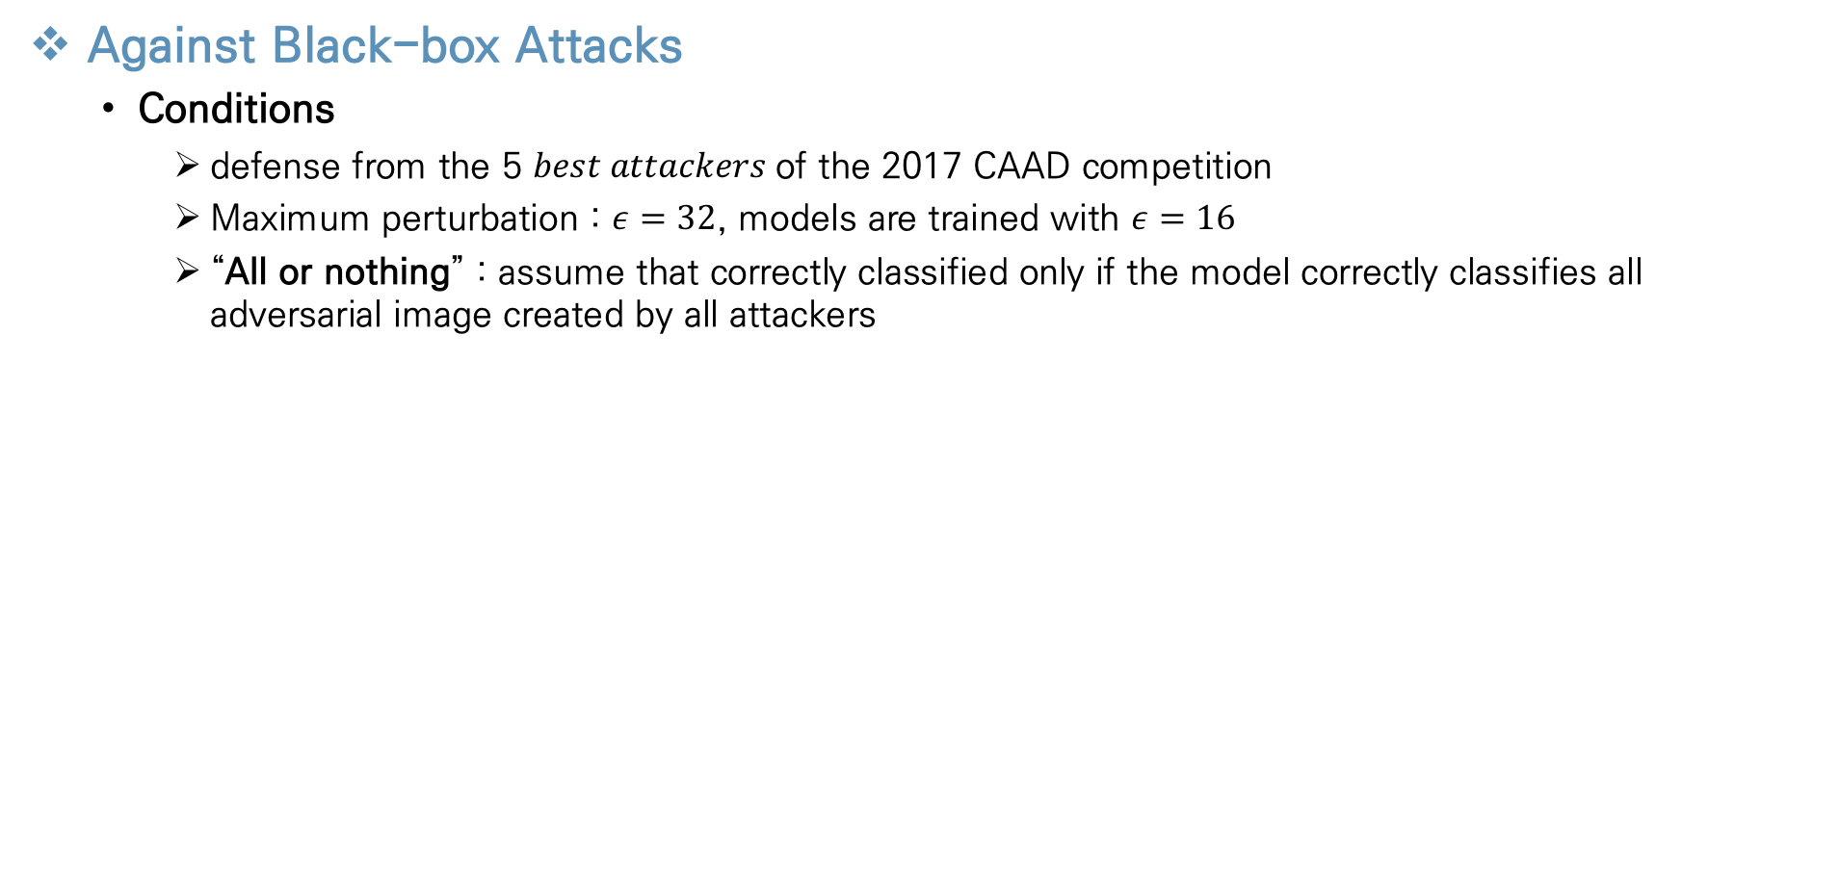
Experimental Results
Against Black-box Attacks
Conditions
defense from the 5 $best attackers$of the 2017 CAAD competition
Maximum perturbation : $ε=32$, models are trained with $ε=16$
“All or nothing” : assume that correctly classified only if the model correctly classifies all adversarial image created by all attackers
[1]
CAAD winner has only 0.04% accuracy
Suggest that a successful implementation of adversarial training is critical for adversarial robustness
Add denoising blocks to all residual blocks
[1]
K. Dabo, A. Foi, V. Katkovnik, and K. Egiazarian. Image denoising by sparse 3-d transform-domain collaborative filtering. TIP, 16(8):2080–2095, 2007..
Notes:
From this page I will introduce about the against black-cox attacks
To evaluate the defending against black-box attacks, they study the 5 best attacker of the 2017 CAAD competition
The maximum perturbation epsilon value is 32 in black box attacker which also makes defense more difficult.
But the epsilon value trained to authors model is 16.
Since it is a black-box-attack, the values of the attacker’s epsilon and the model’s training epsilon are different
And they have one more condition.
It is called “all or nothing” which assume that correctly classified only if the model correctly classifies all adversarial image created by all attackers.
Based on this “all or nothing” condition, the CAAD 2017 winer has only 0.04% accuracy.
Even if two vulnerable attackers are removed, the accuracy is only 13.4.
With this condition, authors RESNET-152 baseline has 43.1% accuracy against all five attackers.
It represent the successful implementation of adversarial training is critical for adversarial robustness
Adding non-local denoising blocks improves the accuracy to 46.4%
Additionally adding denoising blocks to all residual blocks achieves 49.5% accuracy.
It suggests that non-local denoising is also more important than local denoising for robustness against these black-box attackers.

Slide 26
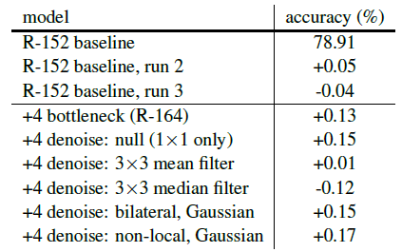
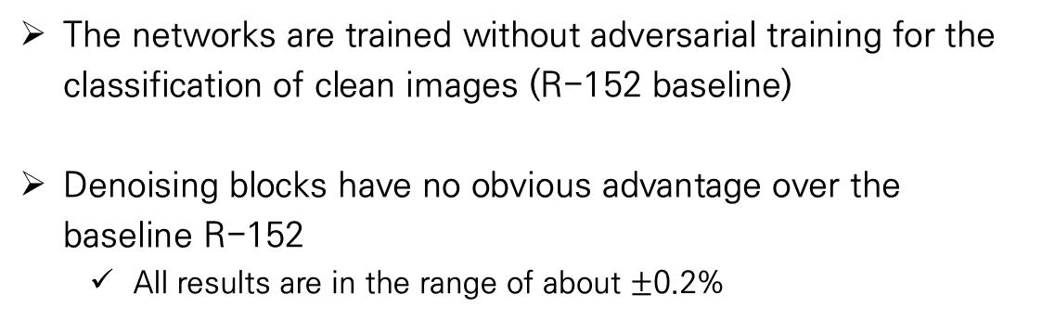
Experimental Results
Denoising Blocks in Non-Adversarial Settings
Non-adversarially trained models
The networks are trained without adversarial training for the classification of clean images (R-152 baseline)
Denoising blocks have no obvious advantage over the baseline R-152
All results are in the range of about $±$0.2%
→ Denoising blocks could have special advantages in settings that require adversarial robustness
Notes:
We have been focusing on denoising blocks for improving adversarial defense.
Since the denoising blocks are combined with the convolutional network layers, these network can also be trained without adversarial training for the classification of the clean image.
It means learning the above network in general.
The table represents the clean image performance of models that are not adversarially trained.
Compared to normal networks, Most of the networks added the denoising blocks have little change.
About +- 0.2%
In conclusion, the denoising blocks could have special advantages in settings that require adversarial robustness.
And denoising blocks are designed to reduce feature noise, which only appears when classifying adversarial images.

Slide 27
Conclusions
Conclusions about this Paper
Focus on the noisy appearance of feature maps from adversarial images
Propose the potential of feature denoising for improving the adversarial robustness of convolutional networks
They suggest the certain architecture designs (denoising blocks) that are particularly good for adversarial robustness
When combined with adversarial training, these particular architecture designs are more appropriate for modeling the distribution of adversarial images
Notes:
So in conclusion.
The authors focused on the noisy appearance of feature maps from adversarial images and thought that these noise lead the networks into making incorrect prediction.
So they proposed the potential of feature denoising for improving the adversarial robustness of convolutional networks
To denoise the perturbations, they suggest the certain architecture designs called denoising blocks that are particularly good for adversarial robustness
When they contain these blocks to the network, and combine with the adversarial training, these particular architecture designs are more appropriate for modeling the distribution of adversarial images

Slide 28
Thank You!

